Slide 1
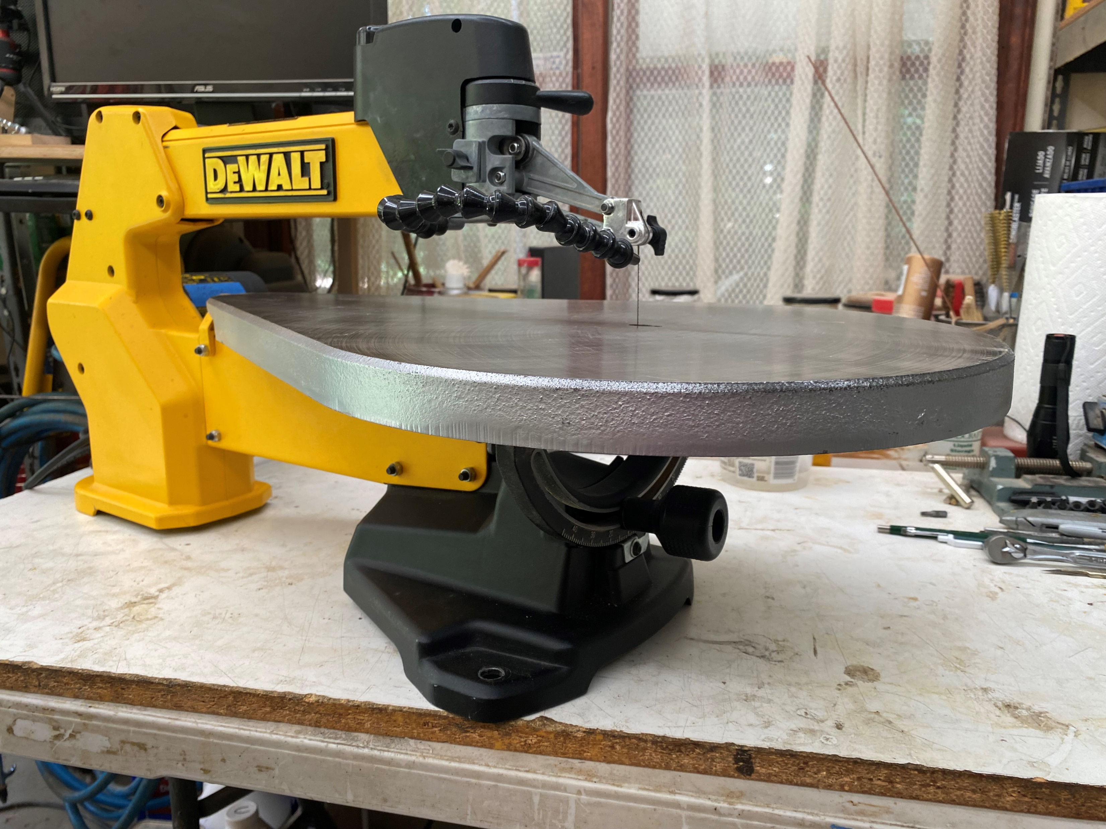
Scroll Saw Maintenance 2023

Slide 2
Today’s topics
Those pesky noises
Tracking them down
Parts availability
Not all parts are equal

Slide 3
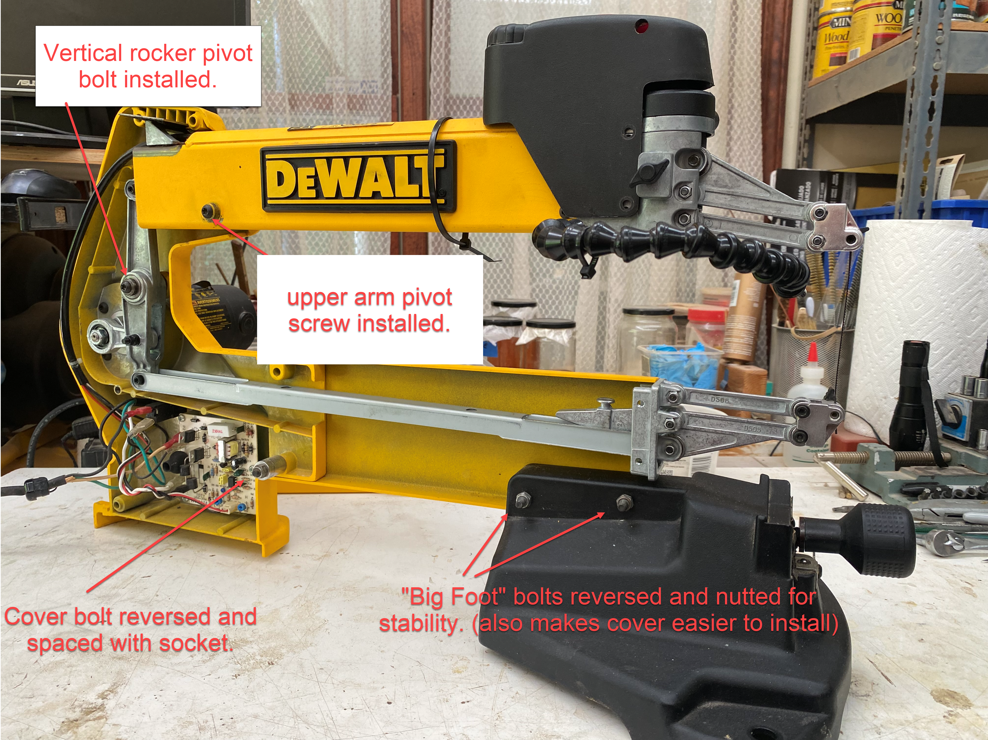
Tracking down the source of the noise
Start by “bench prepping” the saw to operate the saw on the bench top.

Slide 4
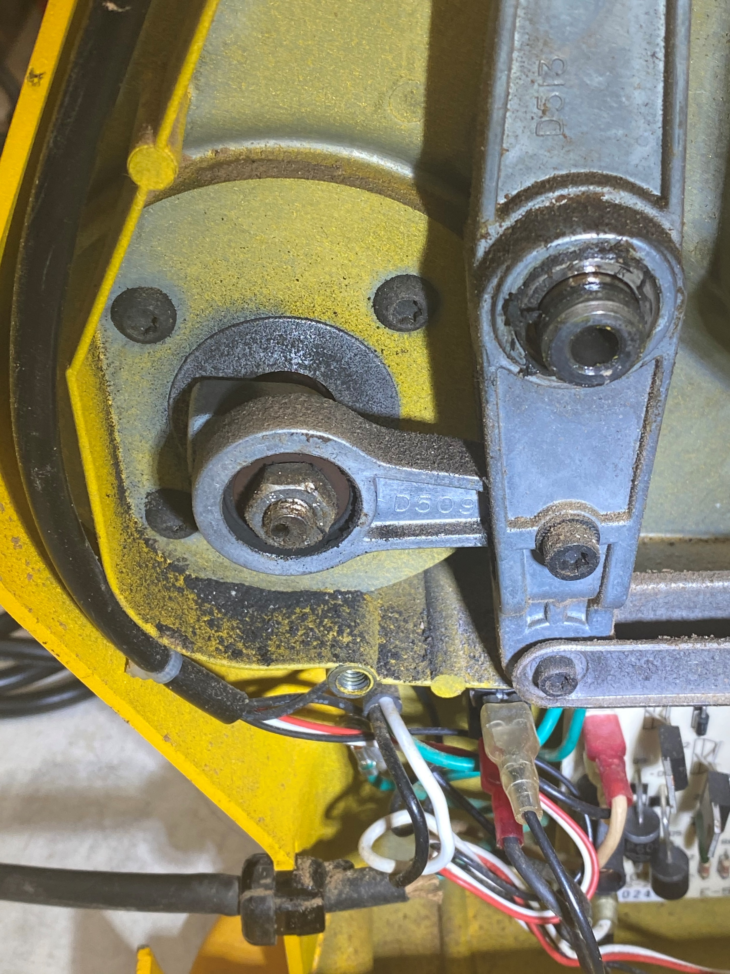
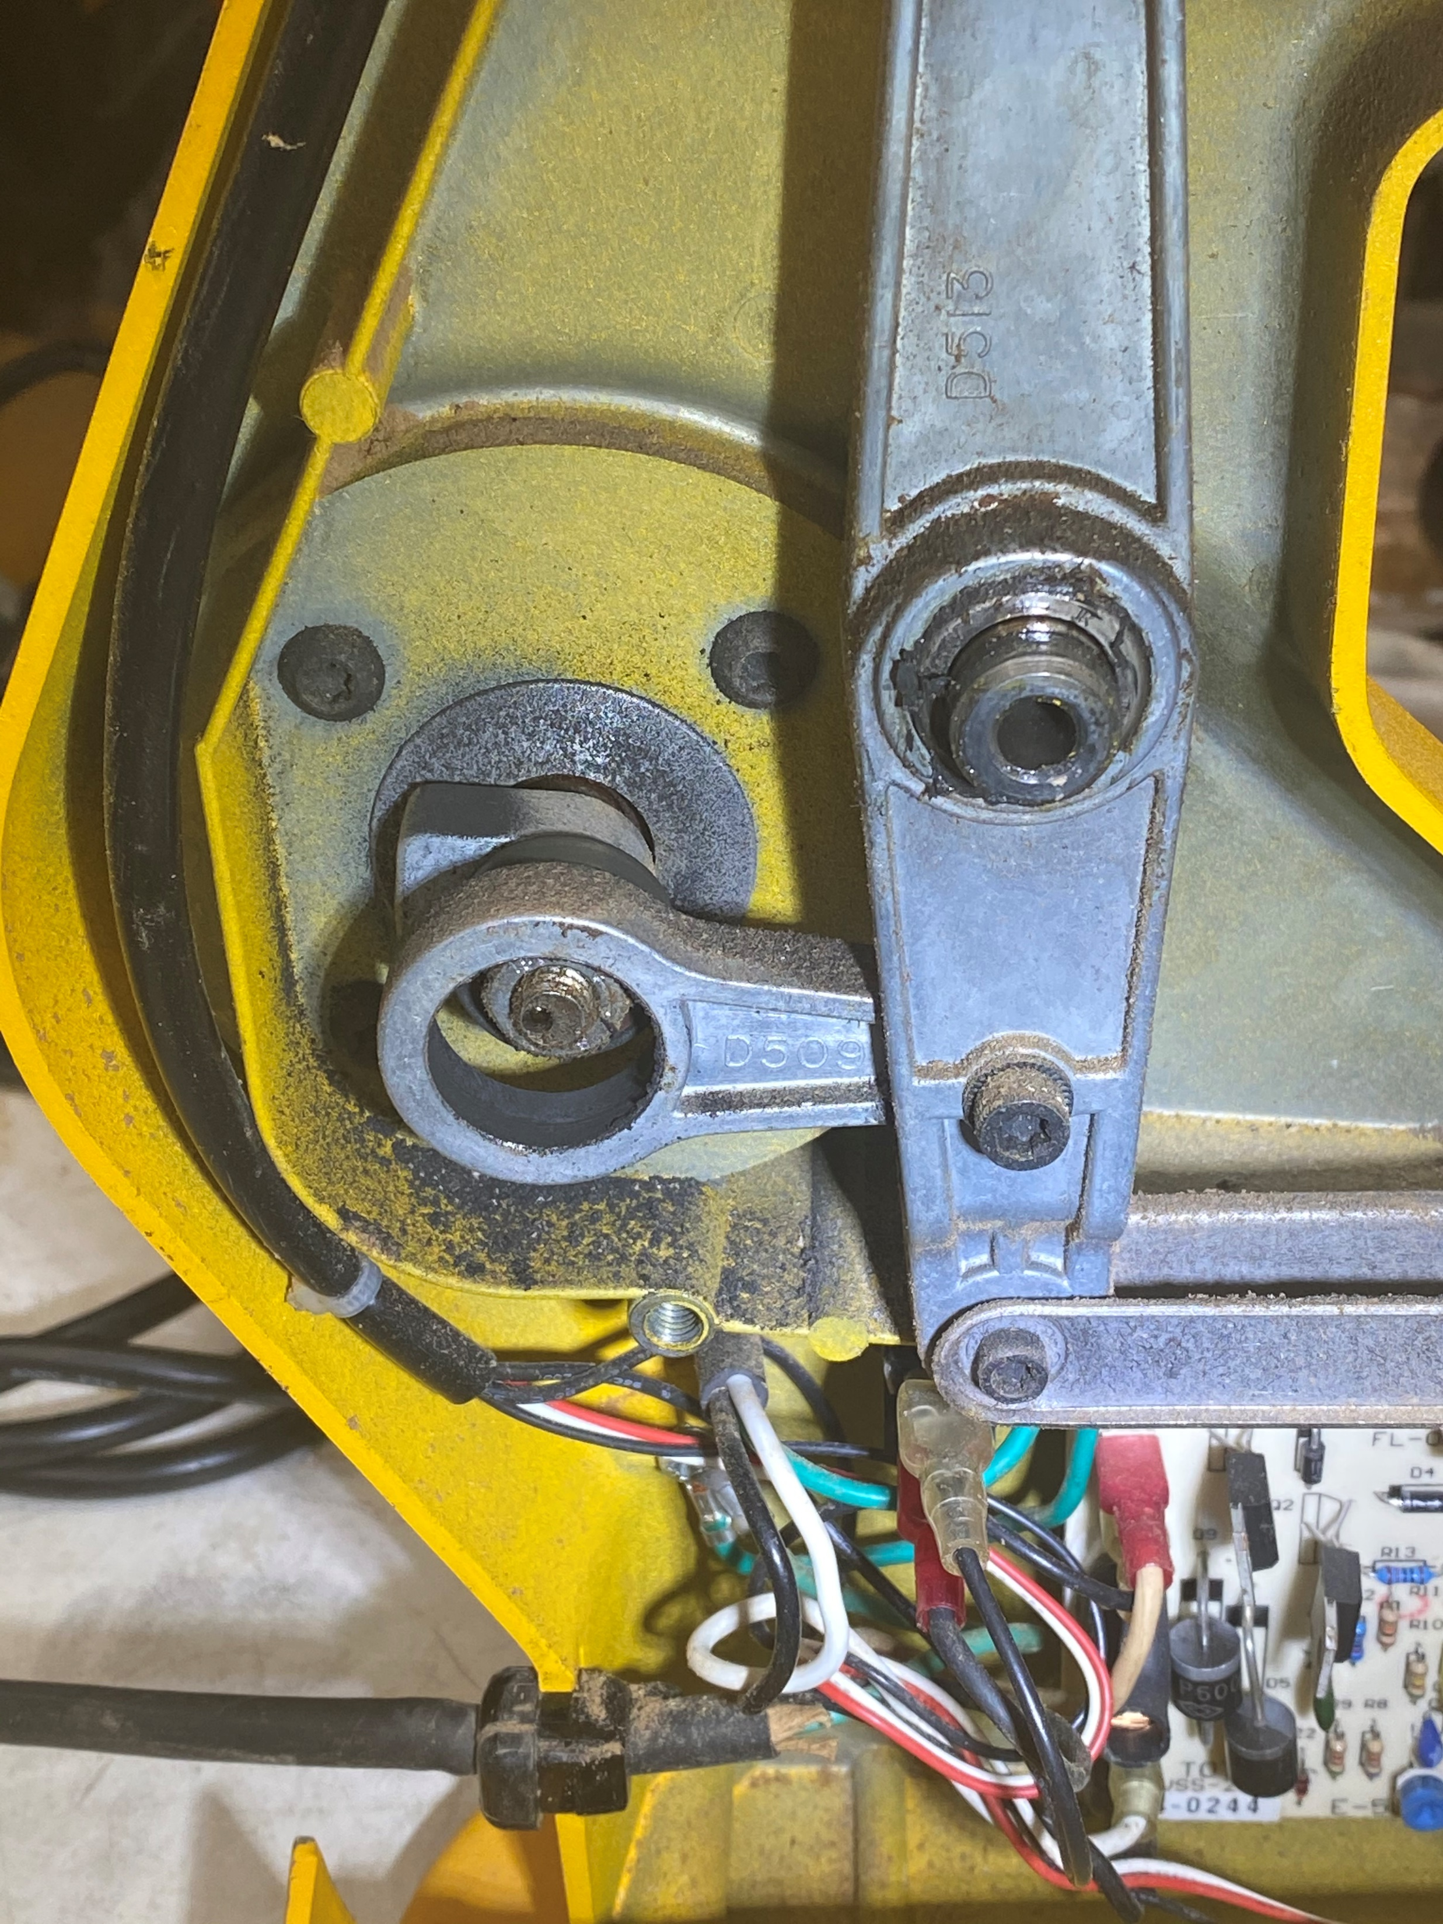
Some sources of noise might be more obvious
Connecting rod bearing failing
Connecting rod failed

Slide 5
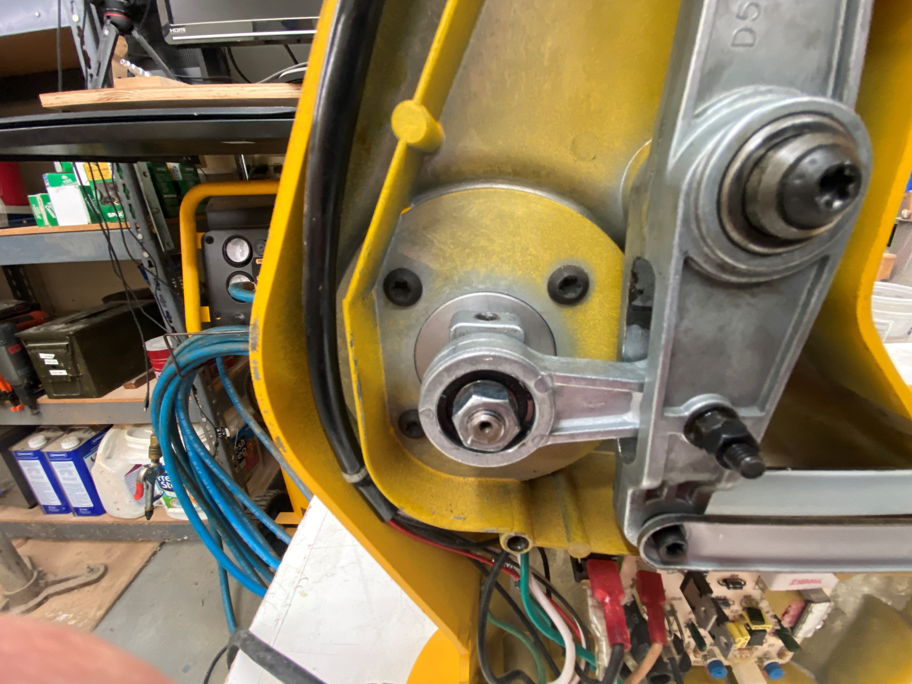
Turn the counter weight straight up for the “wiggle” test.

Slide 6
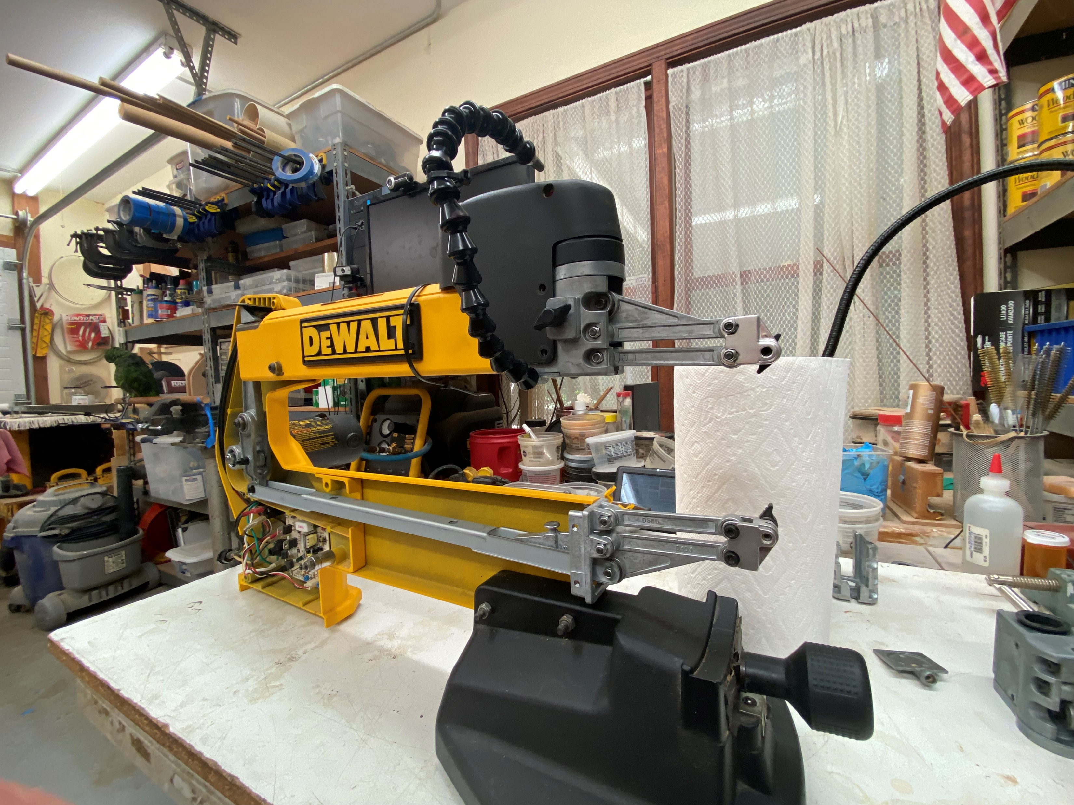
Remove the blade from the chucks

Slide 7
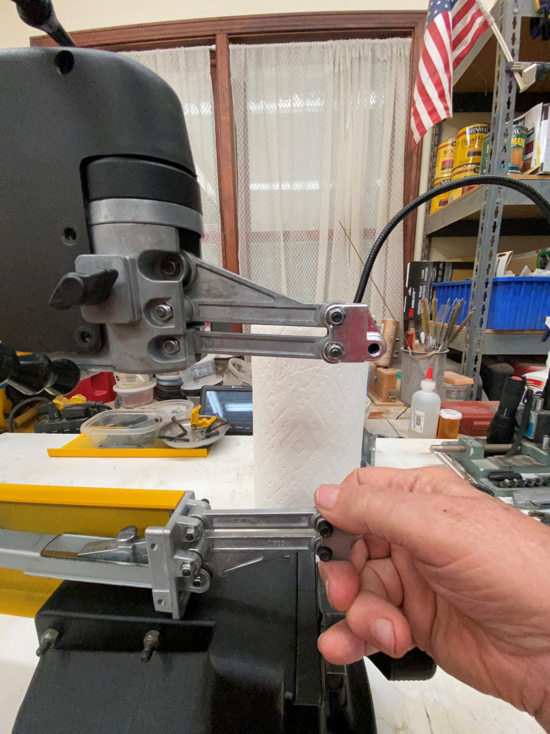
Now for the rocker arm “wiggle” test.
For this test, you need steady hands, good eyes, and concentration.
Begin by resting your hand on the “big foot” and grip the blade chuck as shown.
Attempt to move the lower blade chuck up ever so slowly while watching for movement of the upper chuck.
If there is no slack in any of the connections between chucks, you should not be able to move the lower chuck any without the upper chuck moving.
If needed, reposition the counter weight and/or reverse direction.
If you feel a “thump”, it is most likely bearings in the vertical rocker in the rear.

Slide 8
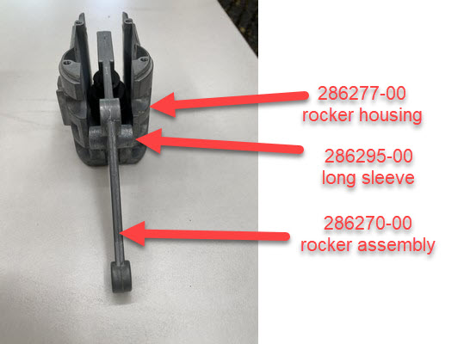
Wearing parts - Upper front rocker casting
Occasionally, the landing pad for the long sleeve gets worn. This requires replacement of the rocker housing.
Parts sourcing

Slide 9
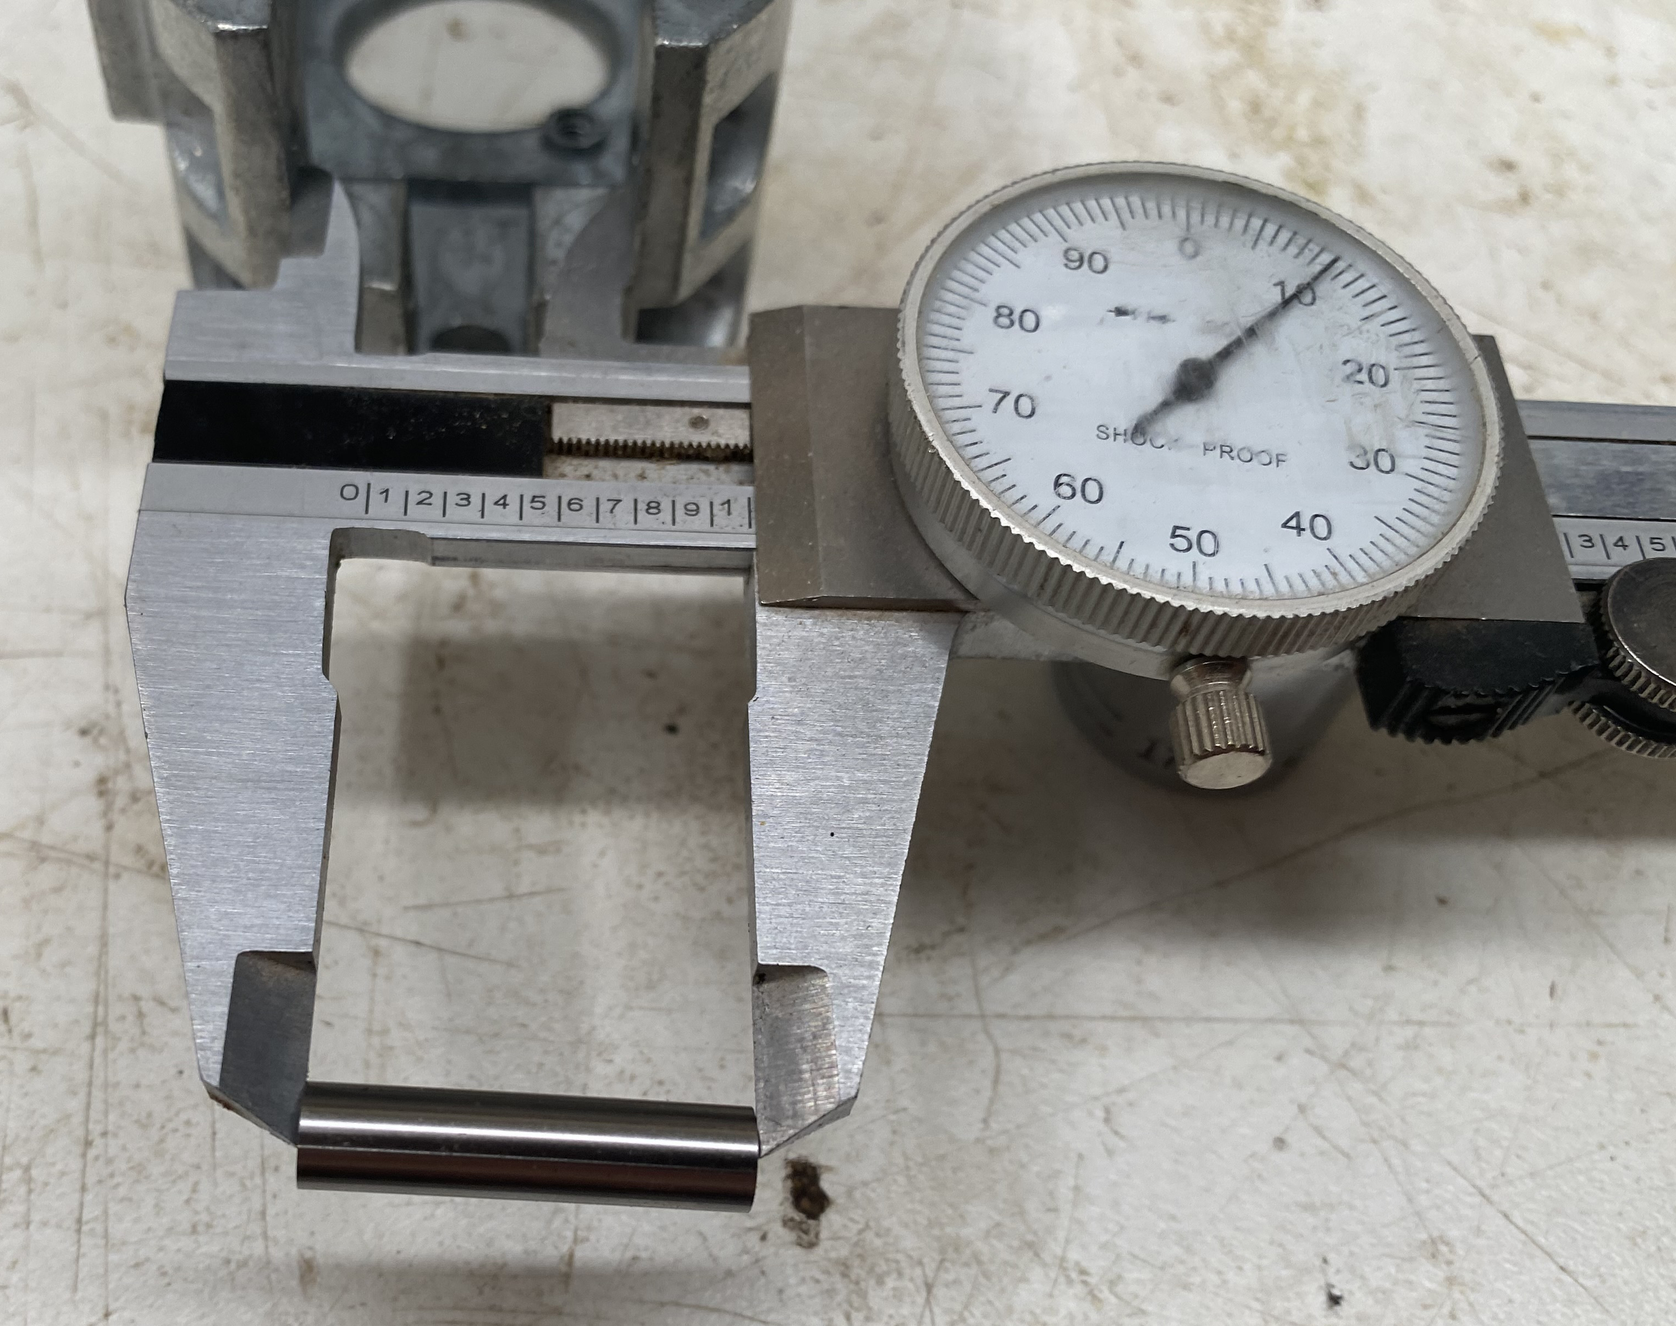
Upper front rocker casting
The caliper shows both the length of bearing sleeve and the dimension between the sleeve pads in the casting.
Parts sourcing

Slide 10
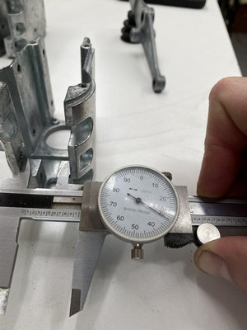
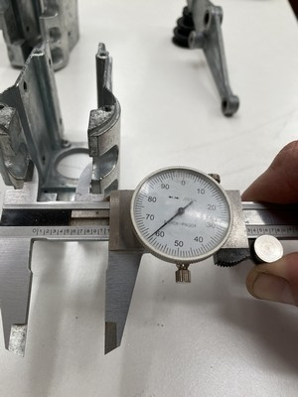
New upper front rocker casting
Three new castings were received from DeWalt.
Lower part of the pad was .020” oversize.
Upper part of the pad was .050” oversize.
DeWalt parts service was unconcerned.
Parts sourcing

Slide 11
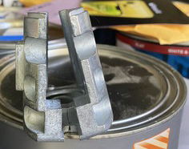
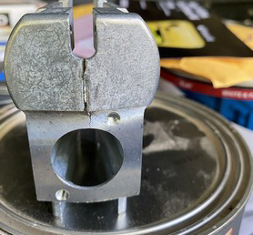
The saga continued with different sources.
The second source (that shall remain nameless) also sourced their parts from DeWalt (as evidenced from the labeling). In addition to the dimensions being wrong, the castings were sent via parcel post in a slightly padded envelope (in background).
The third source only had one of the needed castings in their vintage inventory. The dimensions were as expected and it was shipped in proper packaging.
Parts sourcing

Slide 12
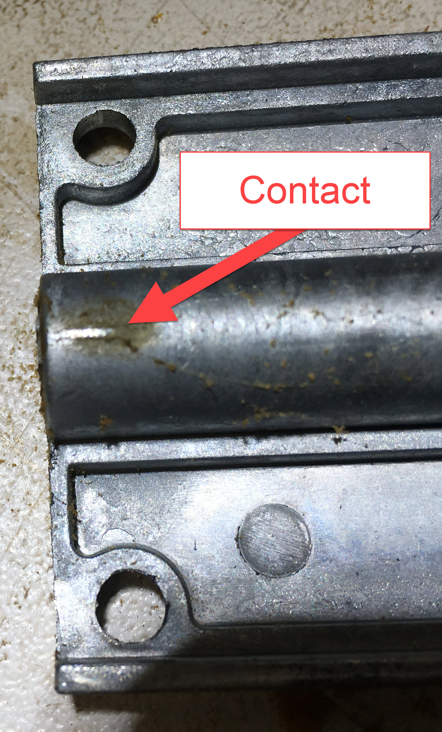
One source of rattle at high speed is the counter weight of the upper rocker colliding with the under side of the tensioner plate .

Slide 13
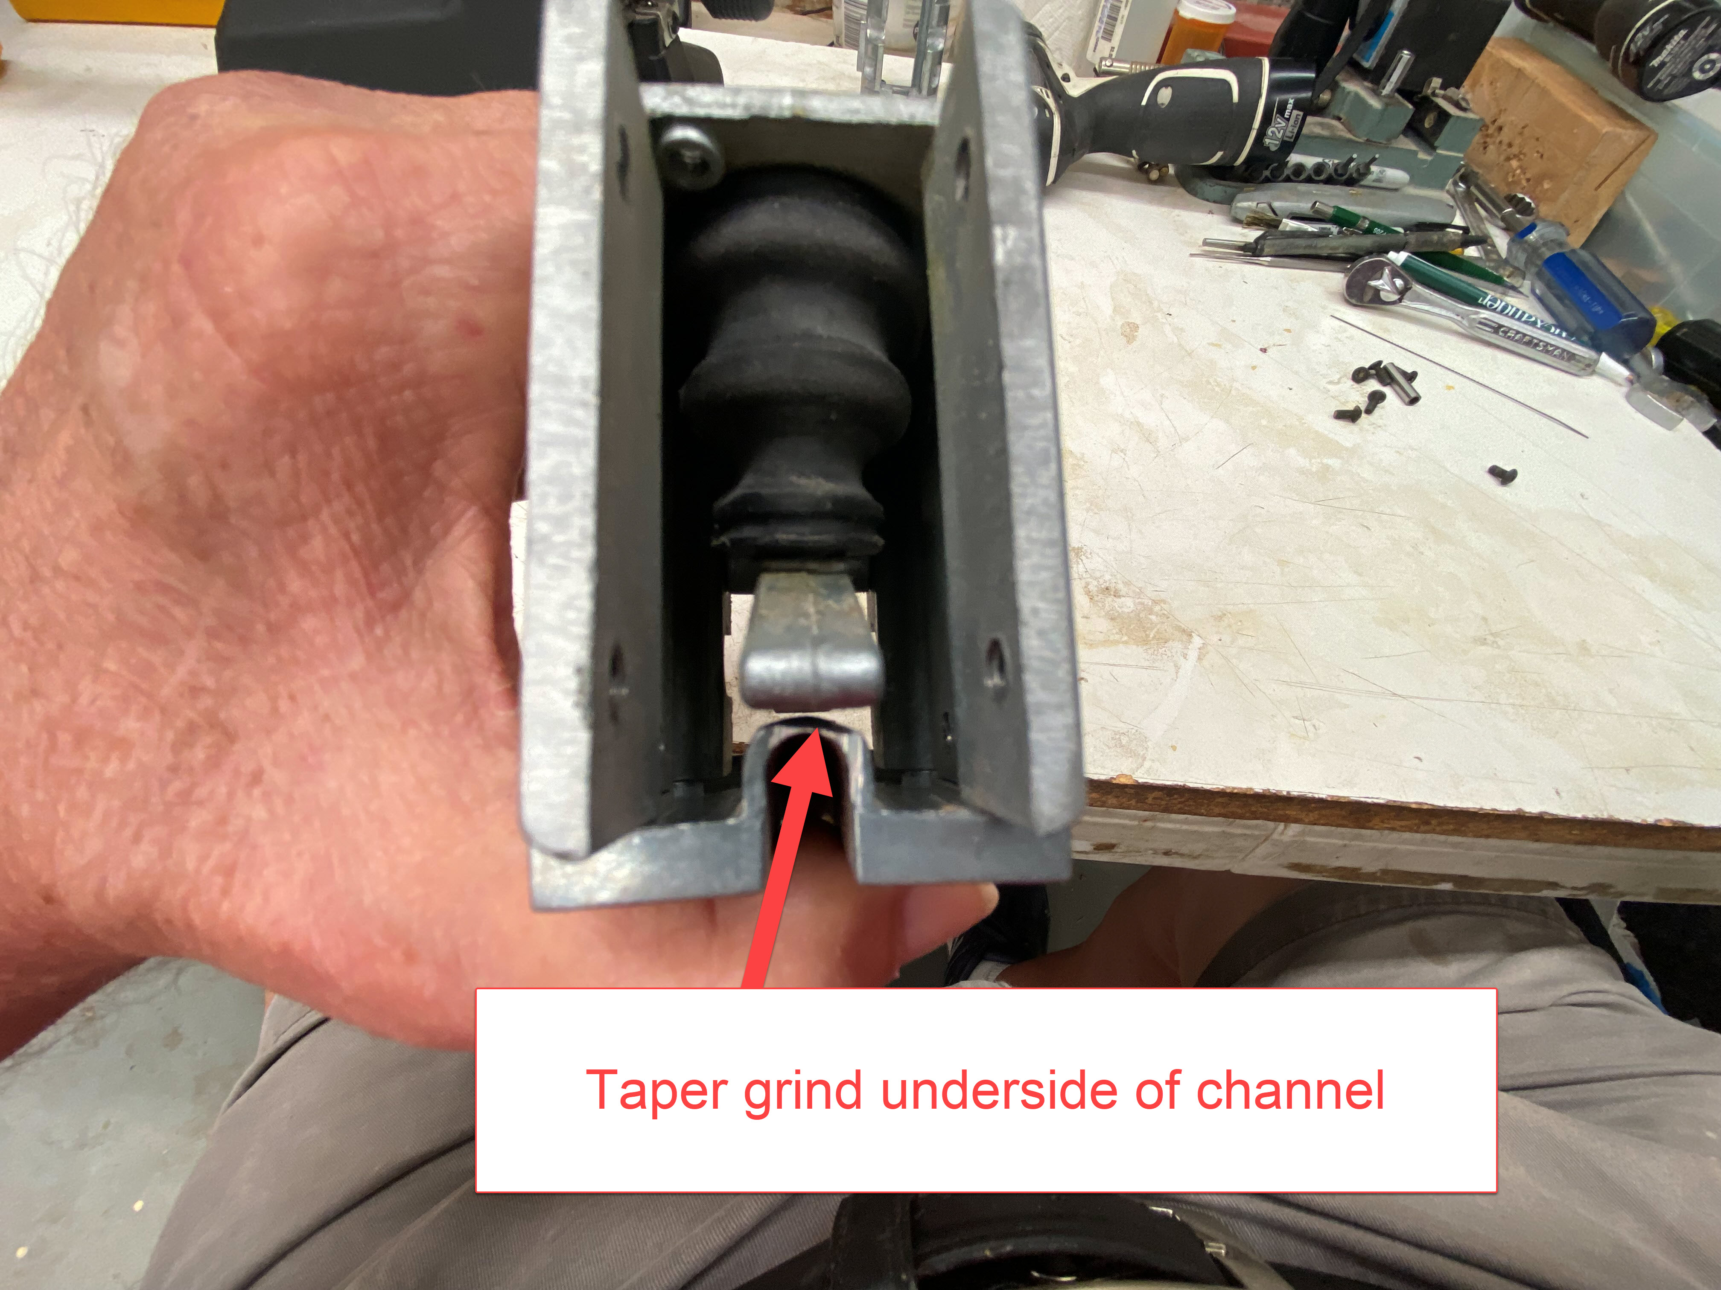
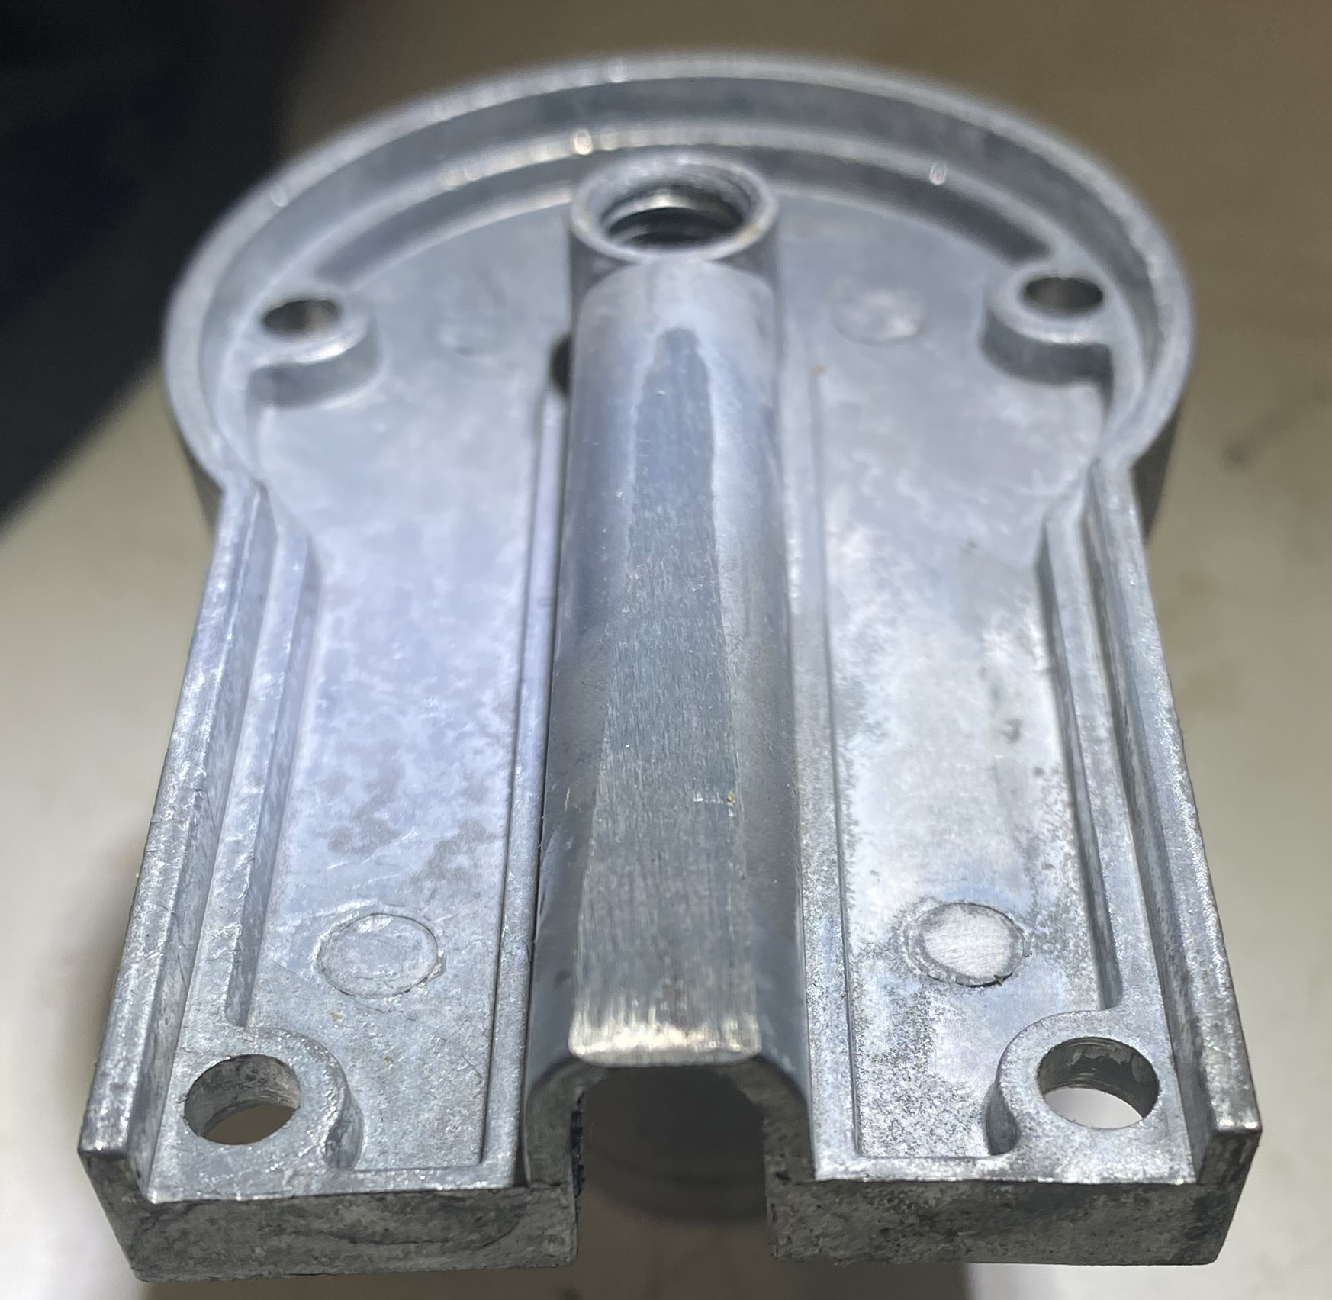
Modify tensioner plate for additional clearance
Vice Grip the tensioner plate and grind the top side of the open end at a taper to provide clearance for the counter weight.

Slide 14
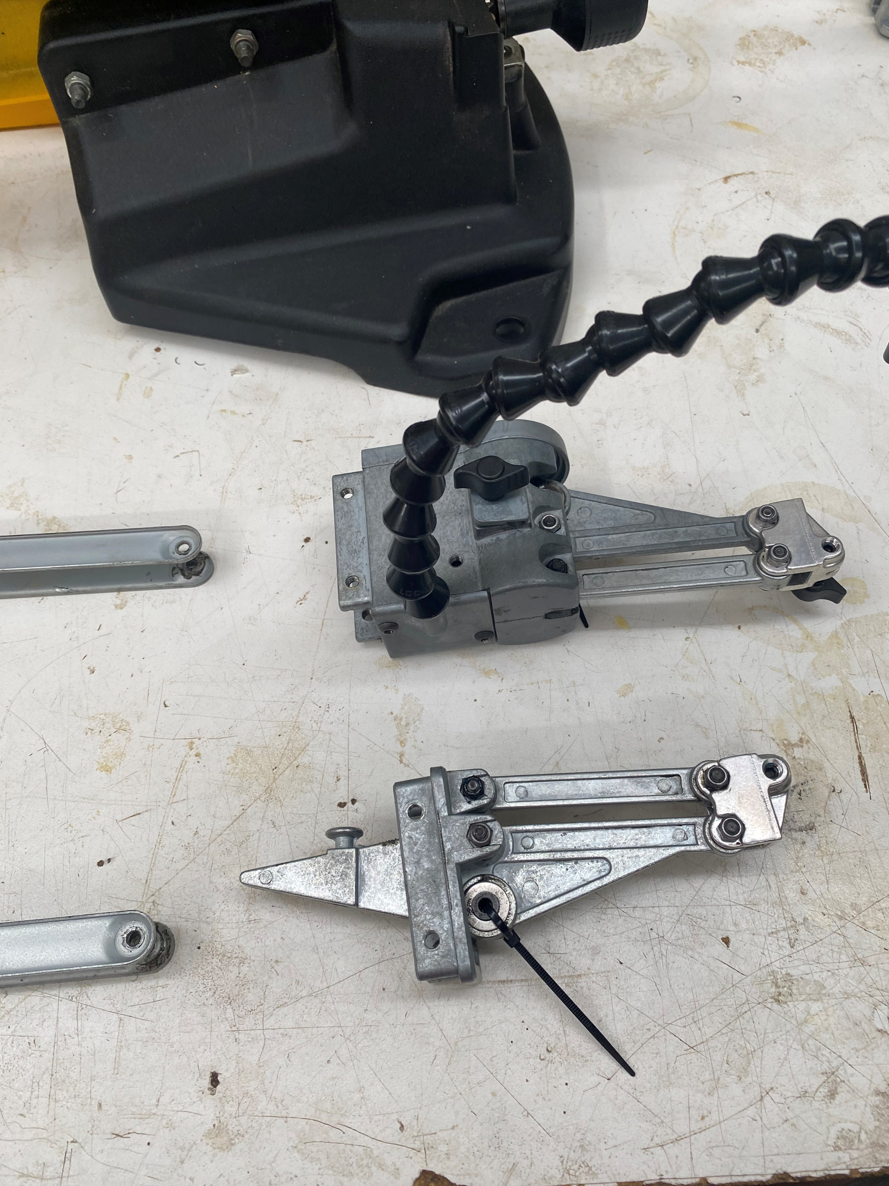
Extracting the rockers for service
To begin servicing the moving parts of the saw, begin by removing the drive linkage bolts from both arms. Unbolt the rocker assemblies from the supporting arms and remove them for later inspection/service.

Slide 15
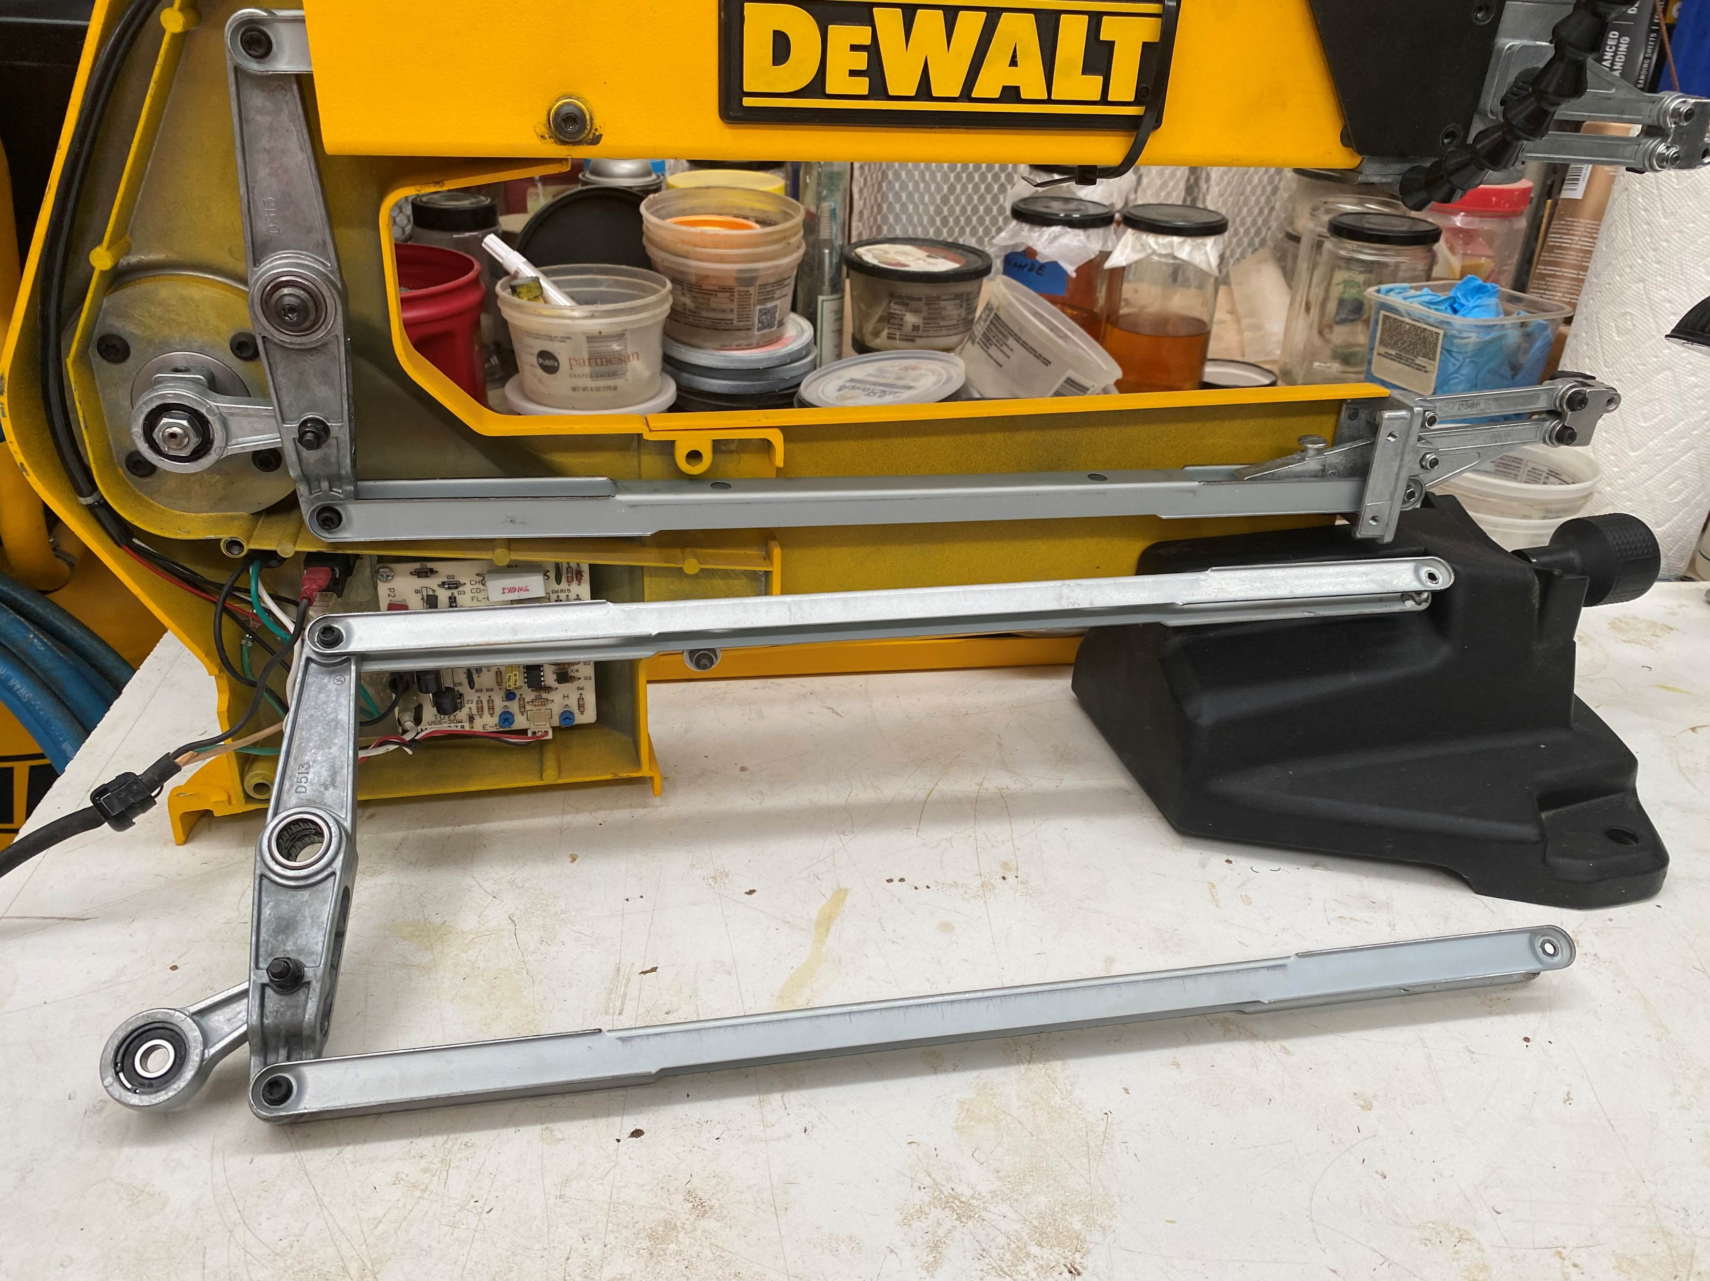
Extracting the vertical rocker and linkages for service
Remove the motor shaft nut (LH thread) (17mm wrench to hold counter weight plus 13 or 12mm wrench (depending on model) ). Remove pivot rod screw and pivot rod. Coax the connecting rod off the motor shaft. You should now be able to pull the lower linkage toward you until horizontal and slide the upper linkage back out of the upper arm.

Slide 16
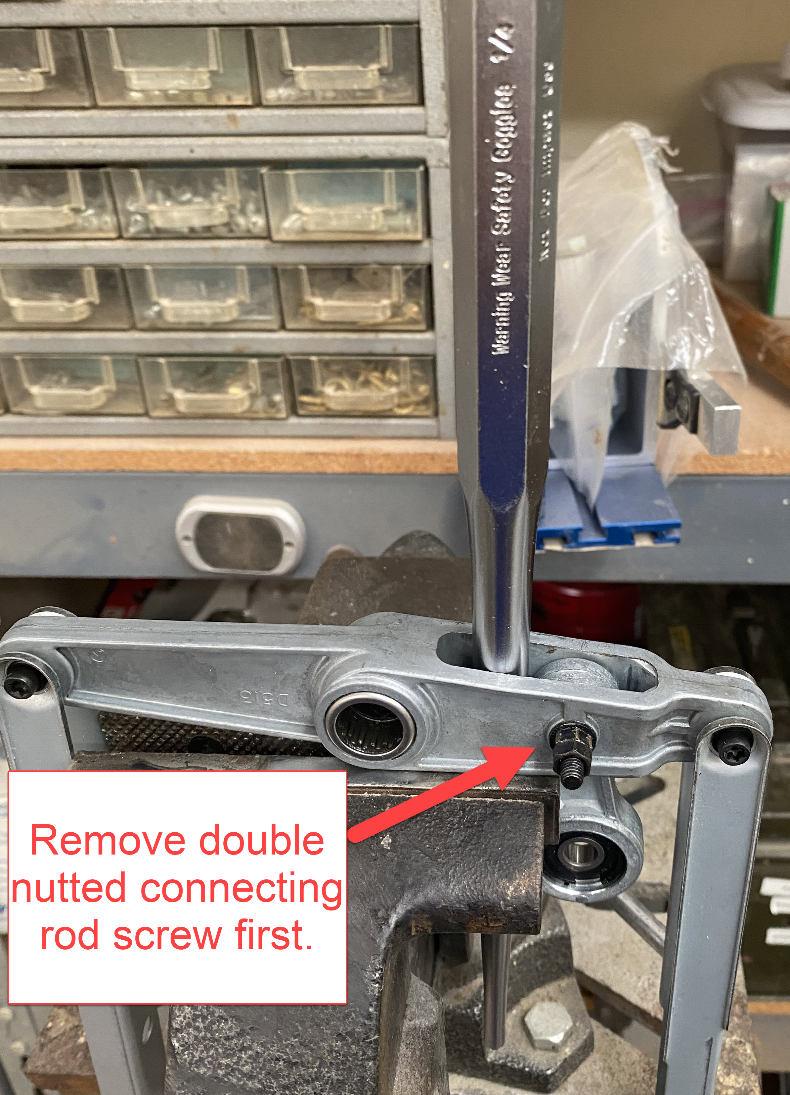
Replacing the connecting rod in the vertical rocker
Begin by removing the double nuts from the connecting rod bolt. Tap out the connecting rod bolt. Position the vertical rocker in a bench vise as shown and drive a ¼” tapered punch into the vertical rocker close to the connecting rod. Continue to drive the tapered punch into the gap until the connecting rod can be pulled out of the bottom. The vertical rocker is a malleable aluminum casting that will restore its shape when the punch is removed. Insert the new, freshly lubricated connecting rod in its proper place and push the connecting rod bolt into place. Blue Loctite the threads on the bolt and reinstall the jam nuts.

Slide 17
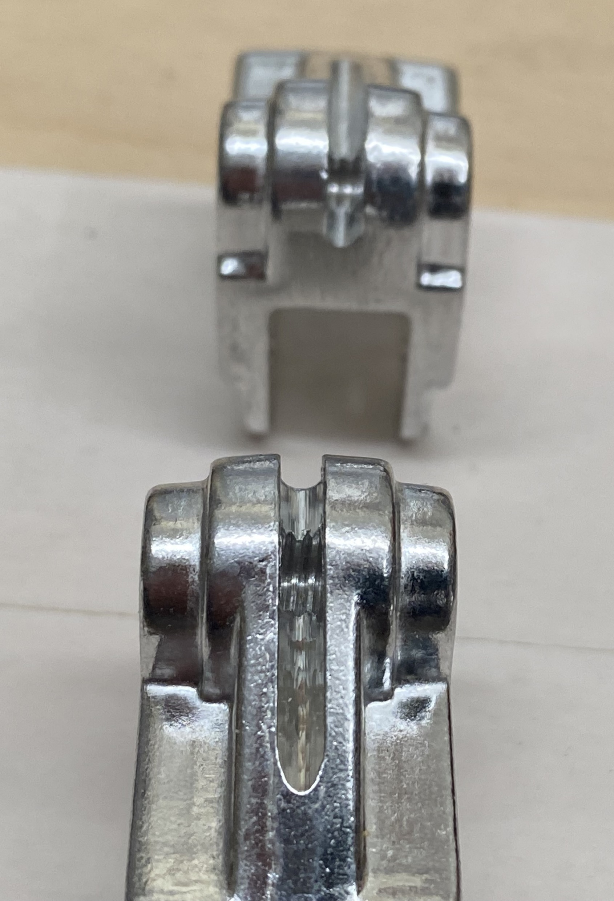
Blade chucks
The DeWalt unit is cast aluminum
Parts sourcing

Slide 18
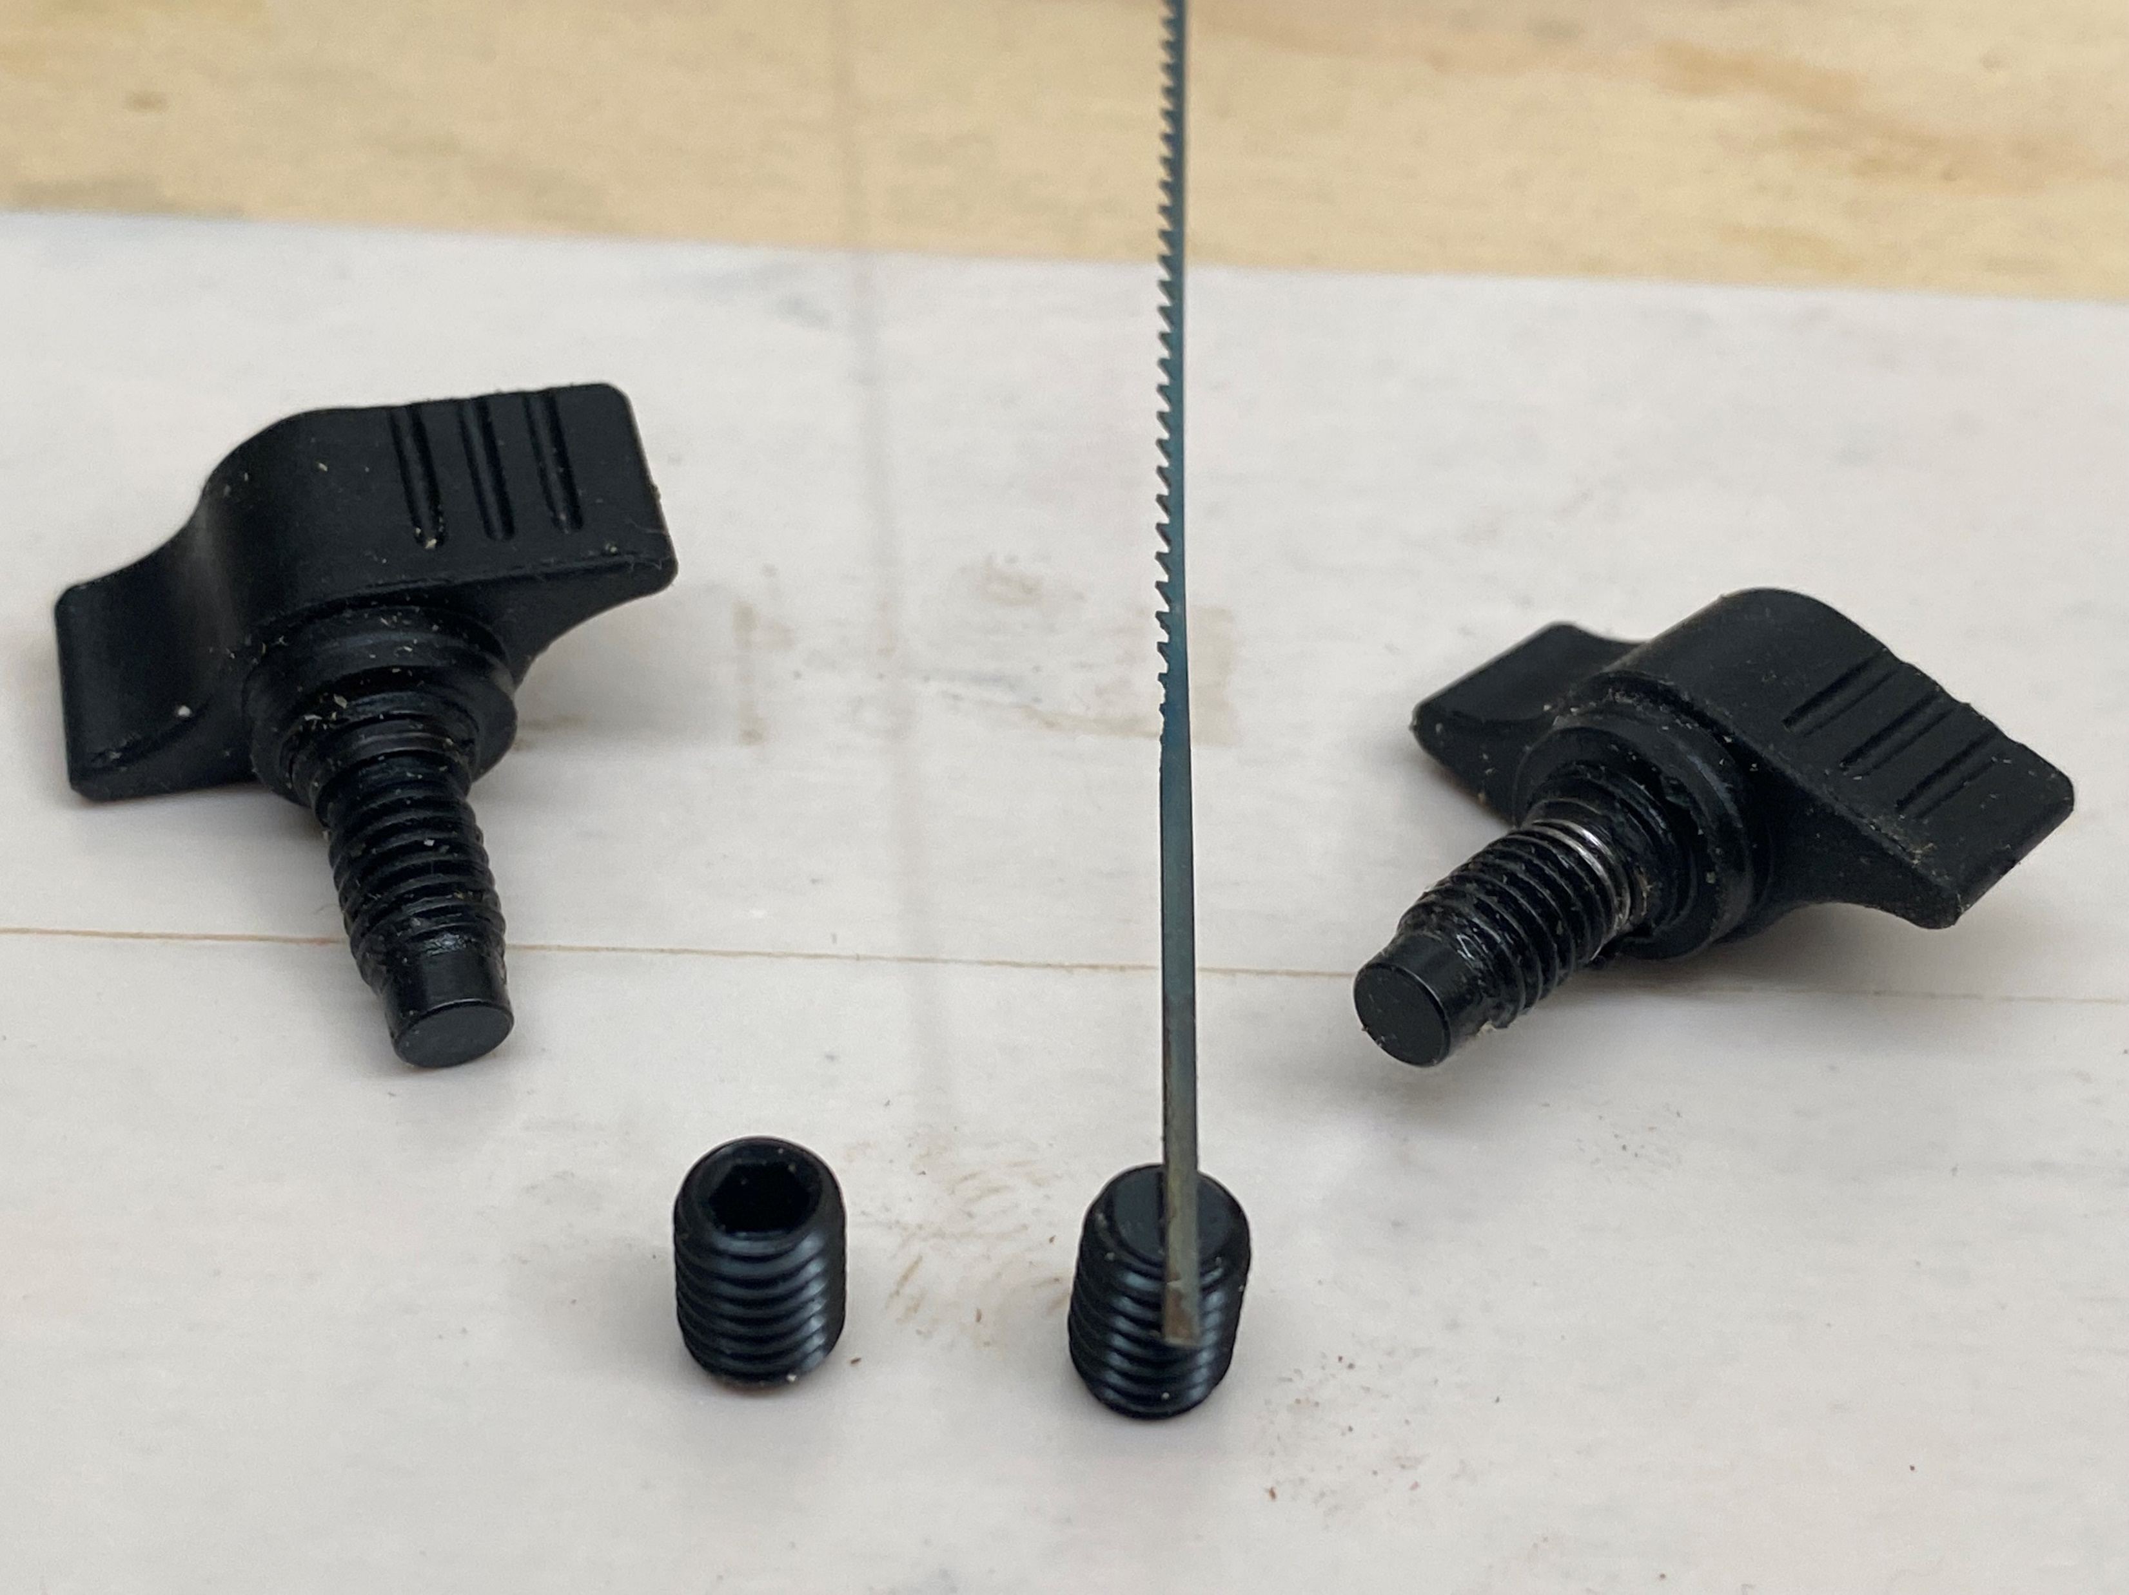
Today’s topics (3cont’d)
Blade clamp(s)
The tee handled blade clamp is fitted with a flat faced “anvil” that rotates under clamping pressure.
It needs to mate up to a flat faced set screw(pictured) to secure the blade.
Source McMaster-Carr
m6 x 1 x 8mm. 12/2019 price $9.25/ 100

Slide 19
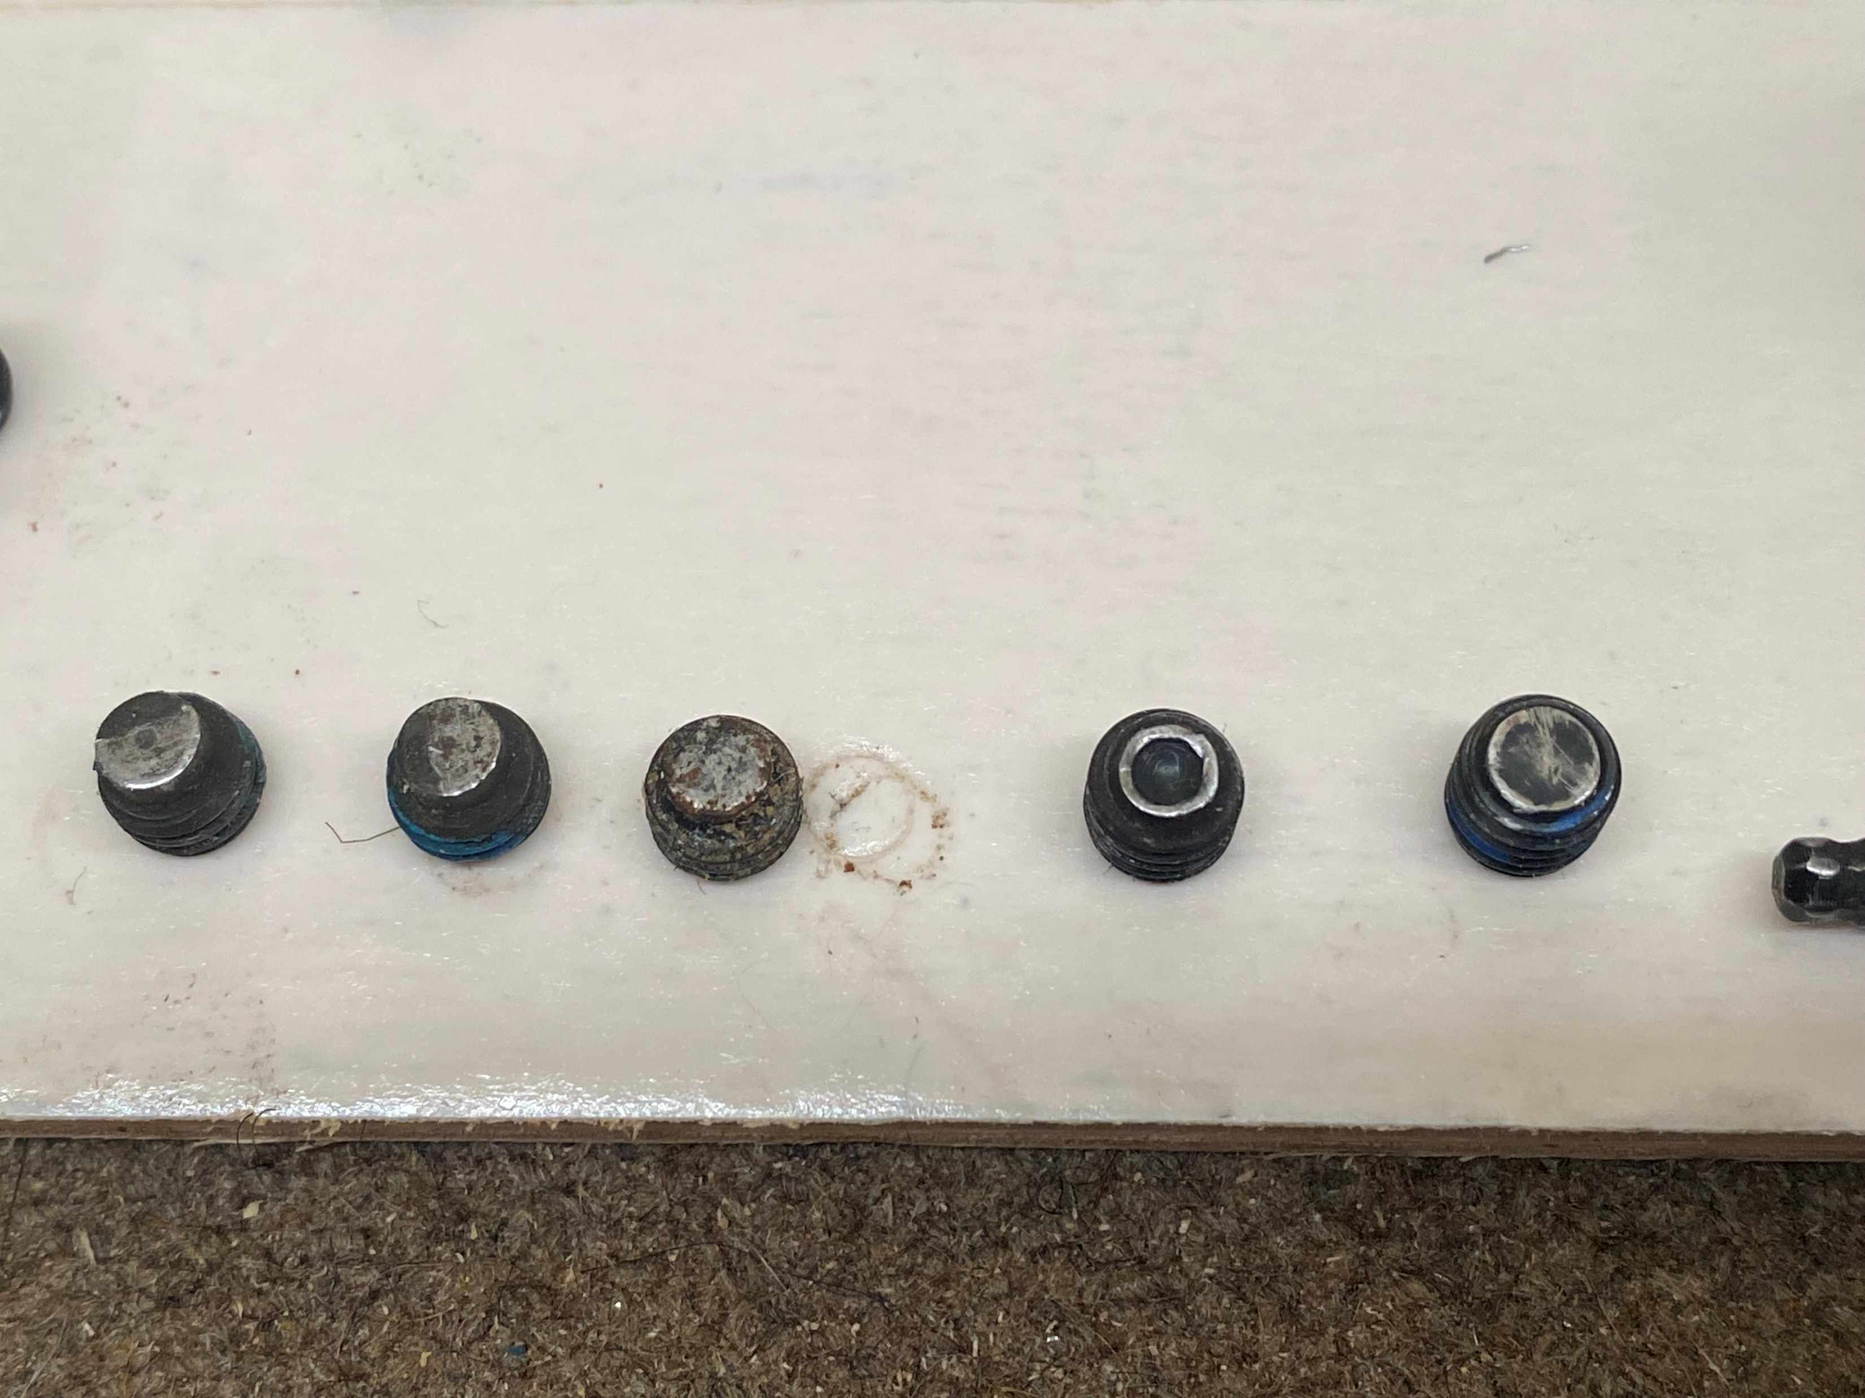
Blade chucks (continued
Blade anvil(s)
The set screws that I have encountered in saws I have serviced (from left to right)
Flat point
Dog point
Half dog point
Small cup point
Cup point

Slide 20
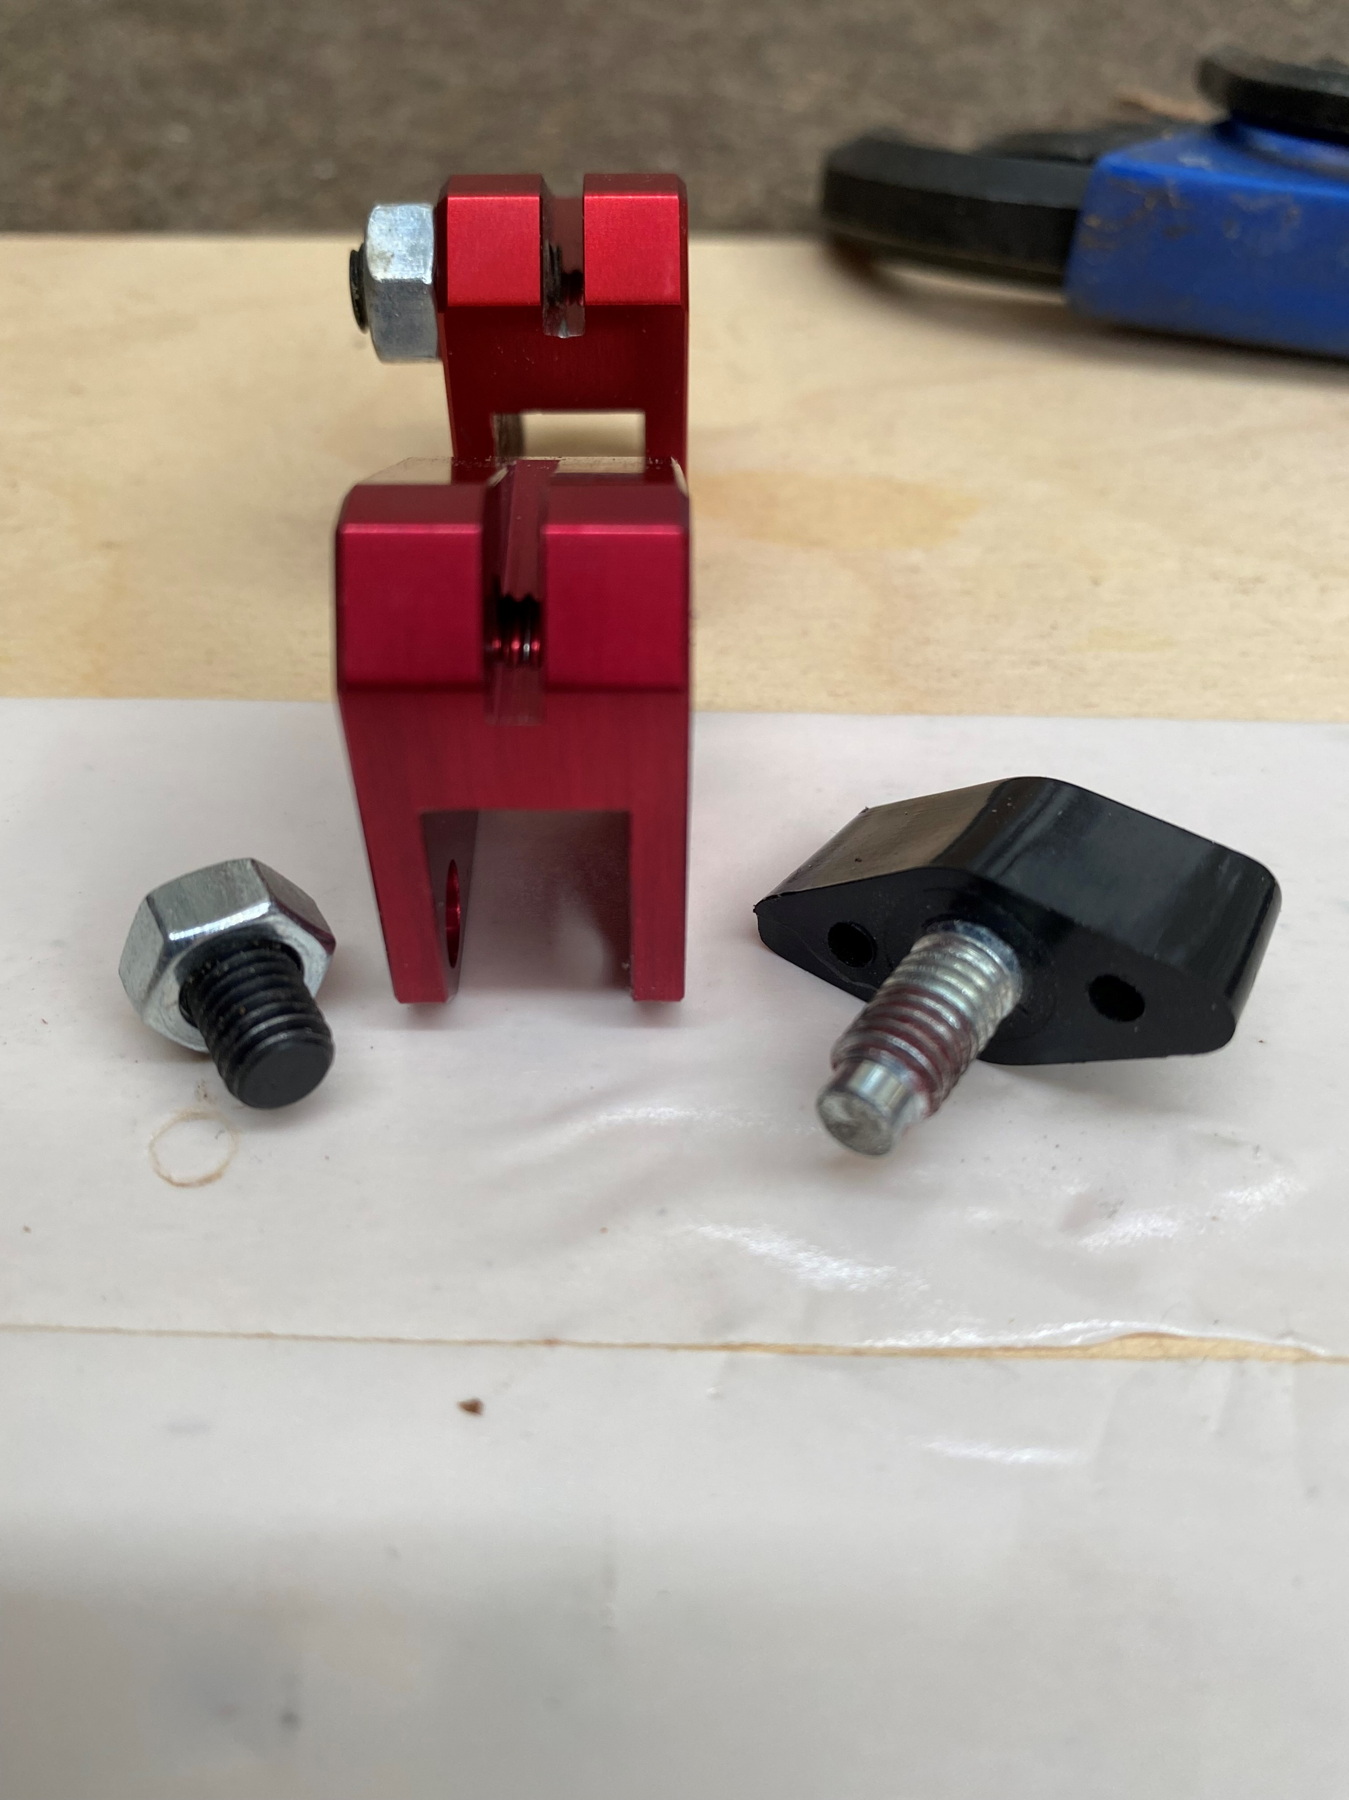
Blade chucks
A few users prefer the aftermarket Pegas chuck. It begins life as a high quality aluminum alloy billet and is machined into the shape shown. It is then anodized with a cranberry red coating.

Slide 21
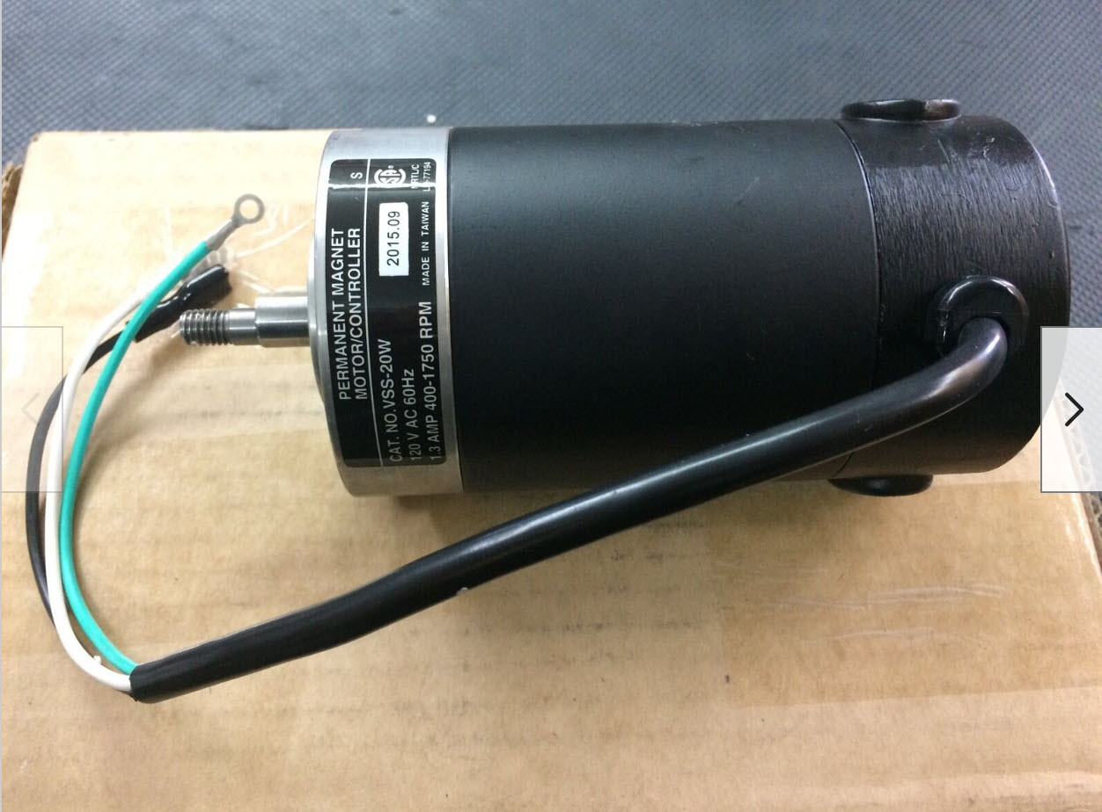
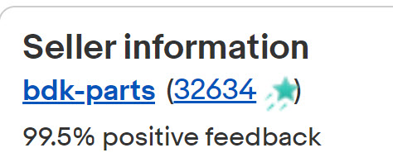
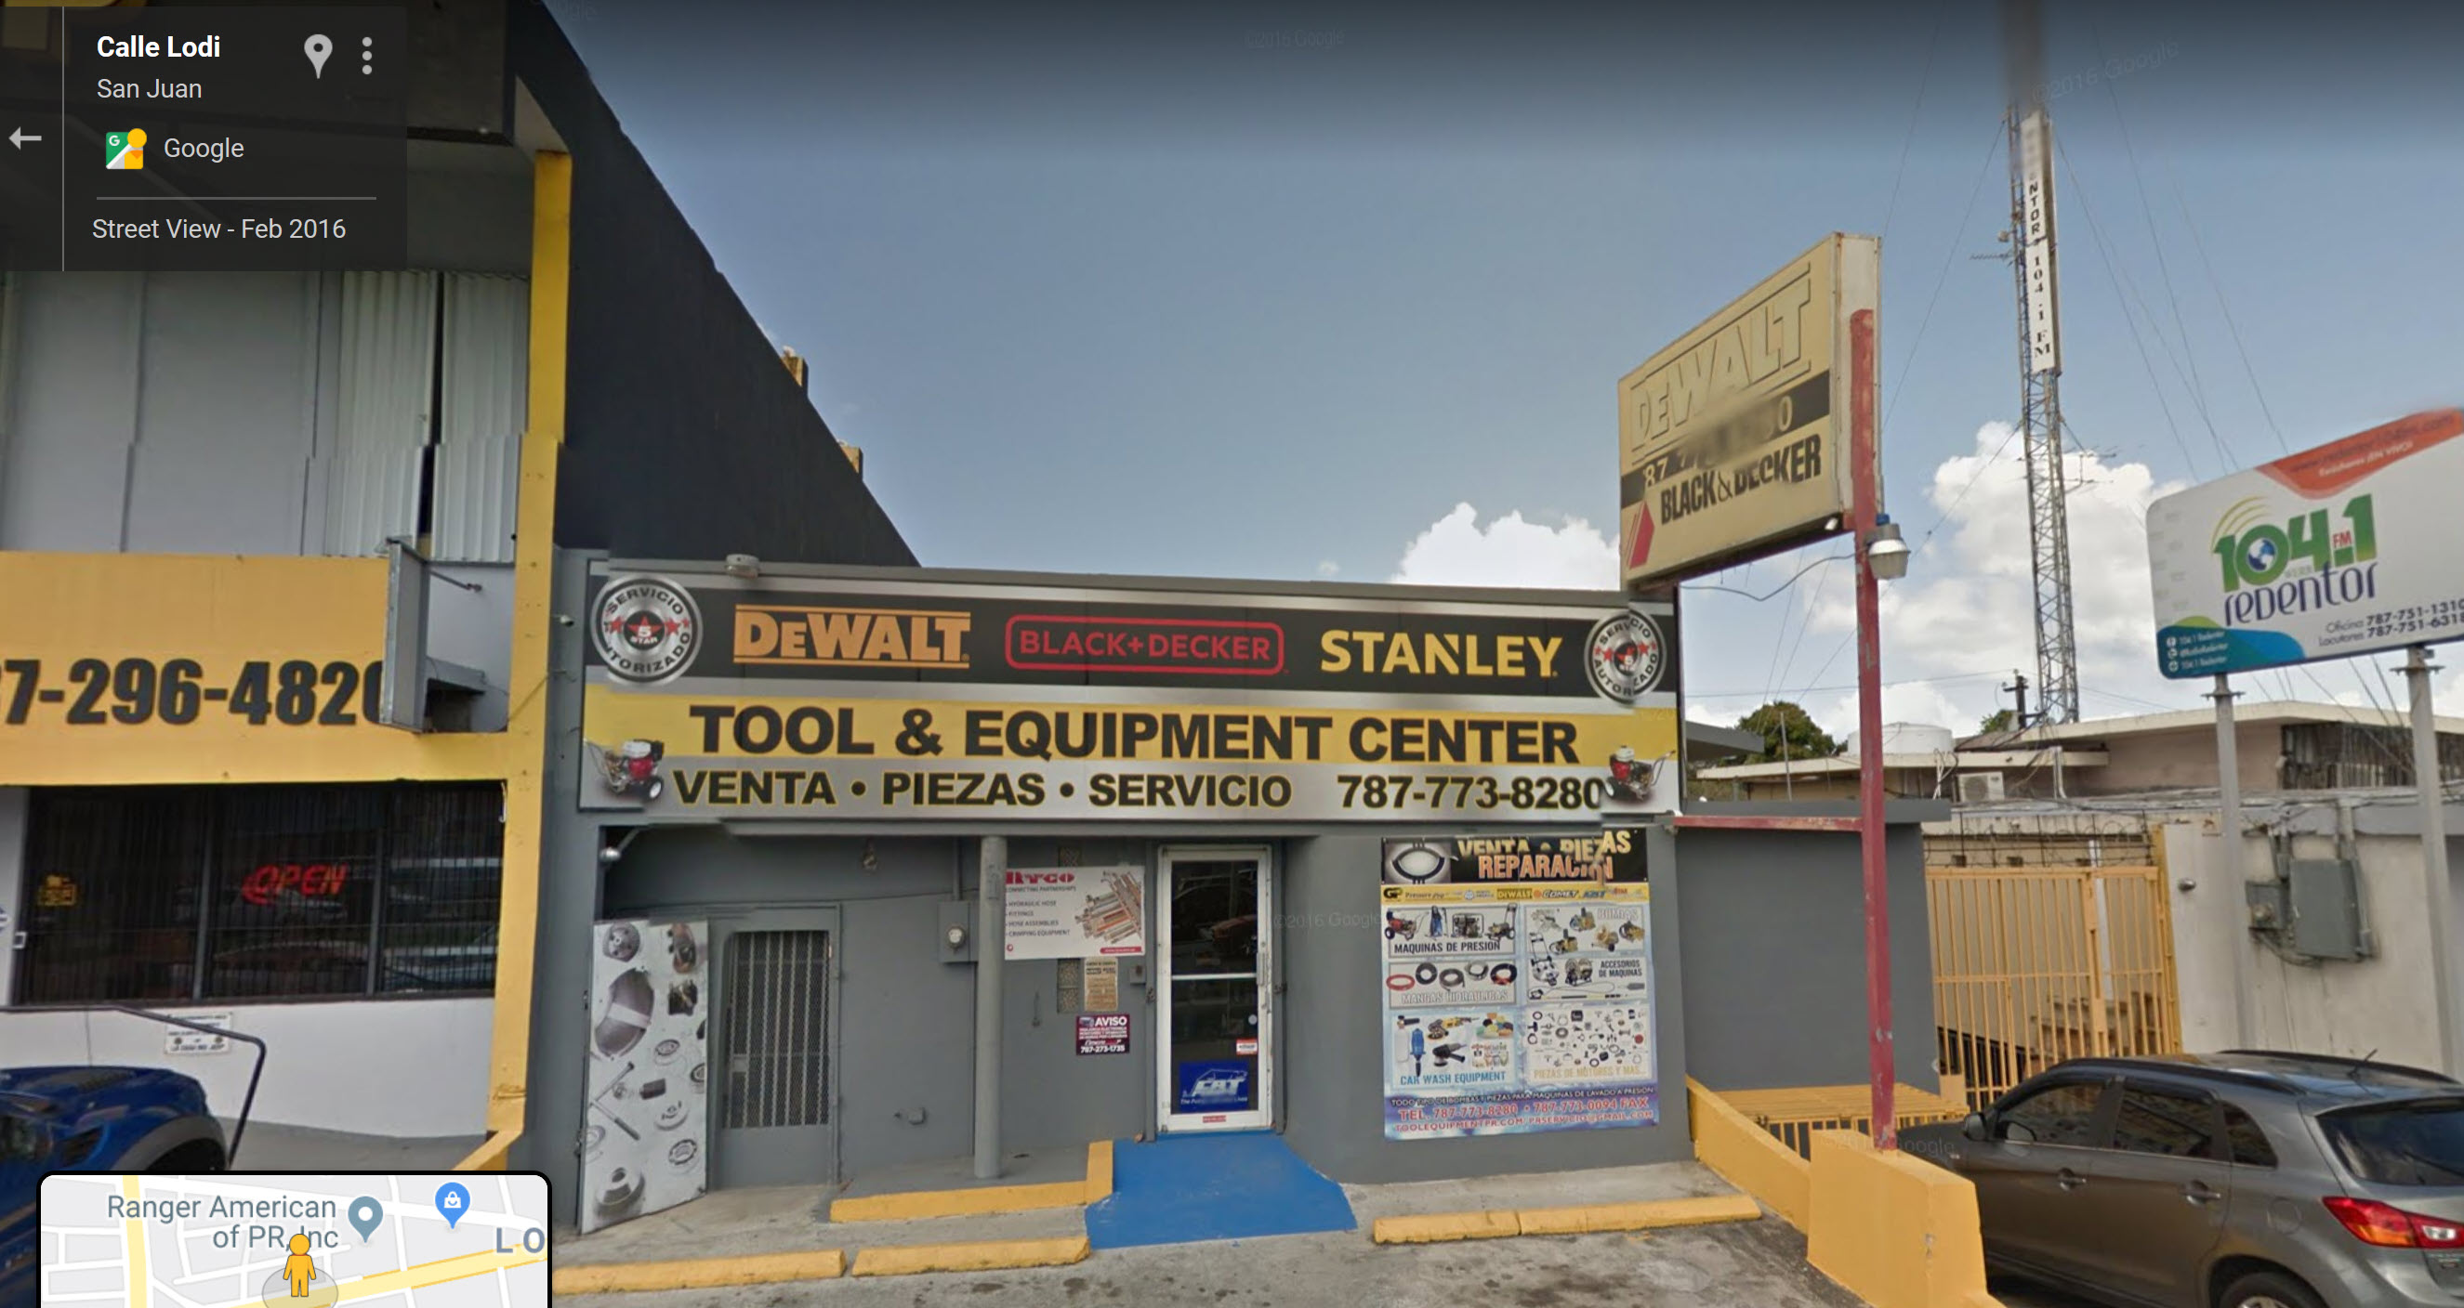
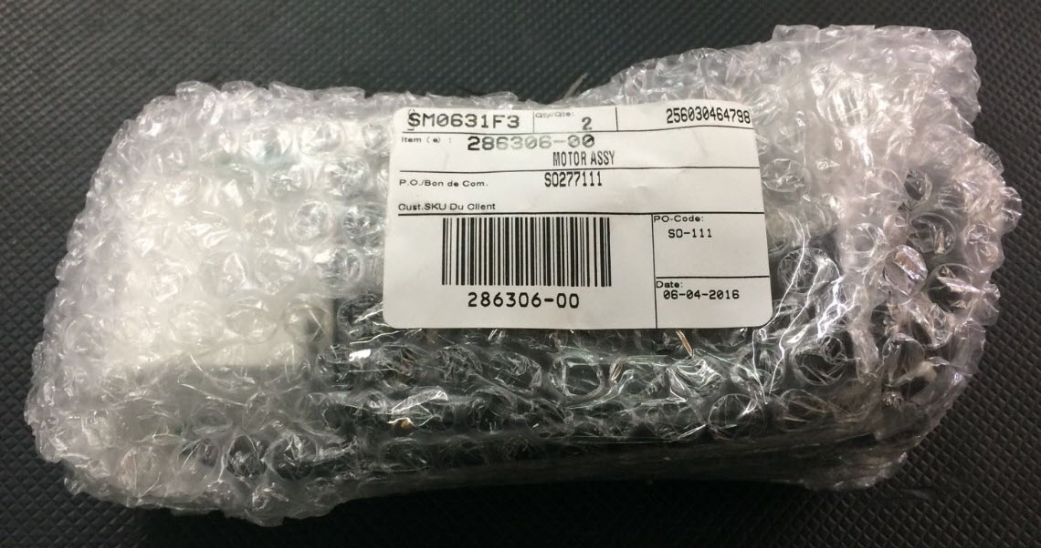
The motor

Slide 22
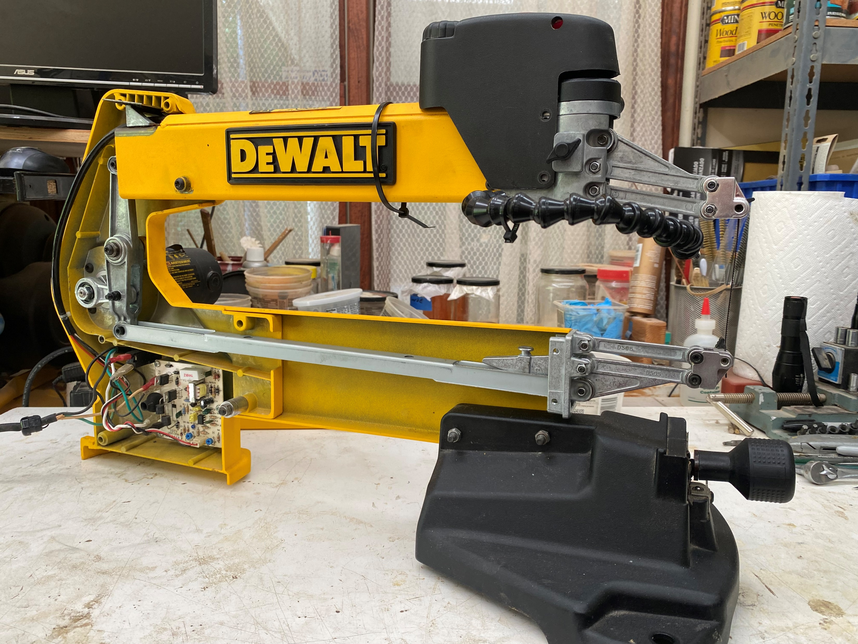
Thank you for your attention

